Slide 1
DQN Walkthrough
Dan Neil
16 April 2015

Slide 2
Quick Paper Overview

Slide 3
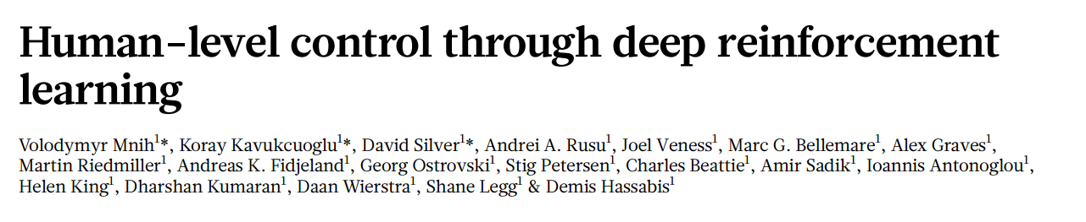
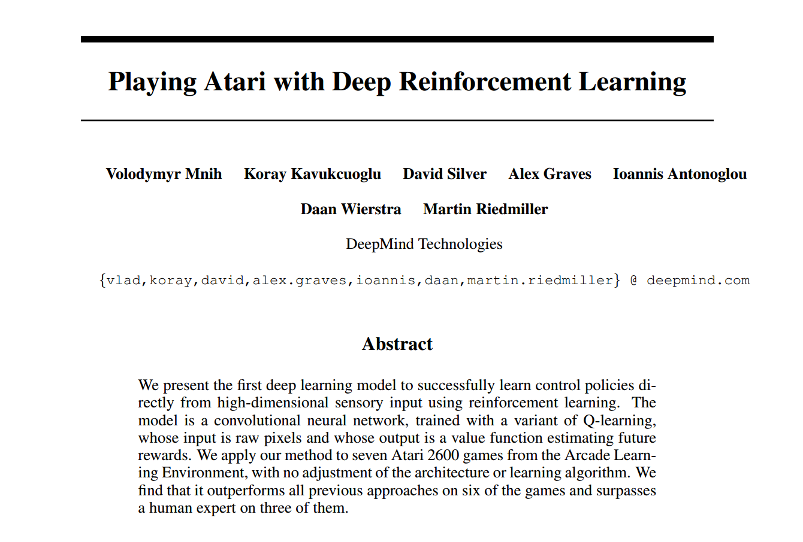
History

Slide 4
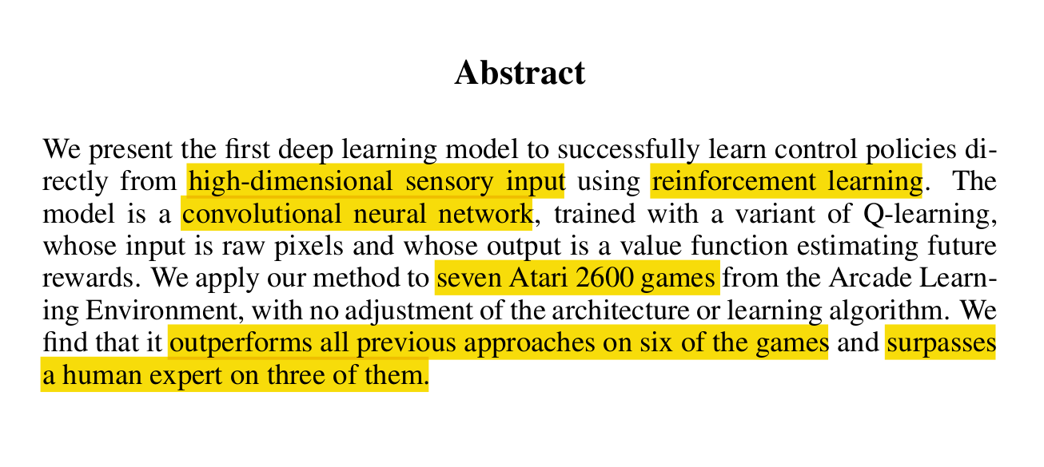
Abstract (Following from Jakob Buhmann)

Slide 5
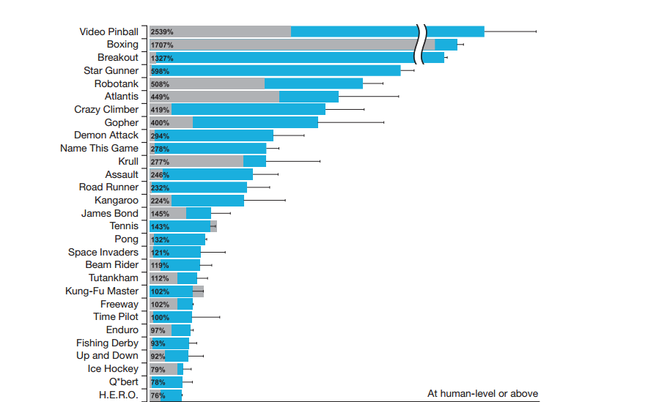
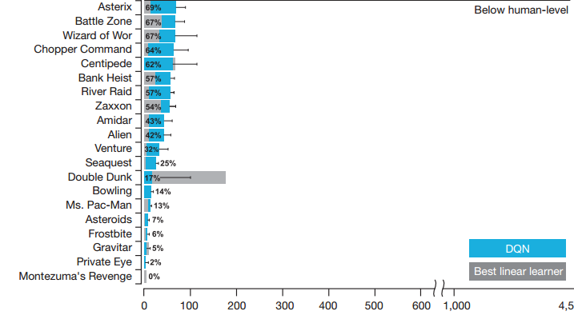
Why DQNs?

Slide 6
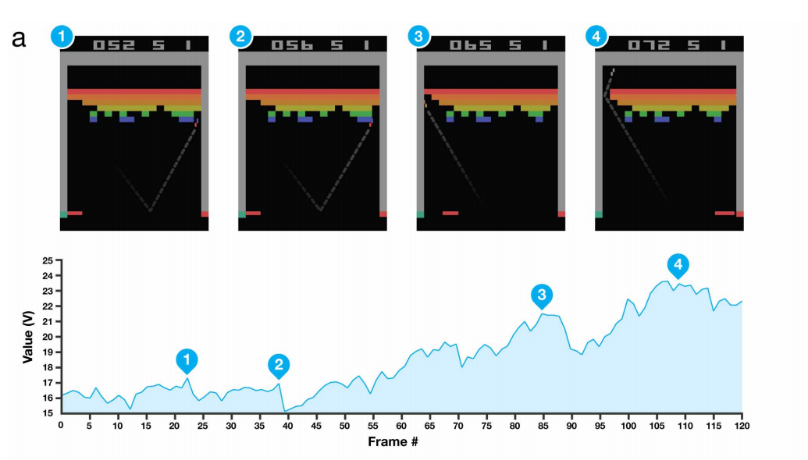
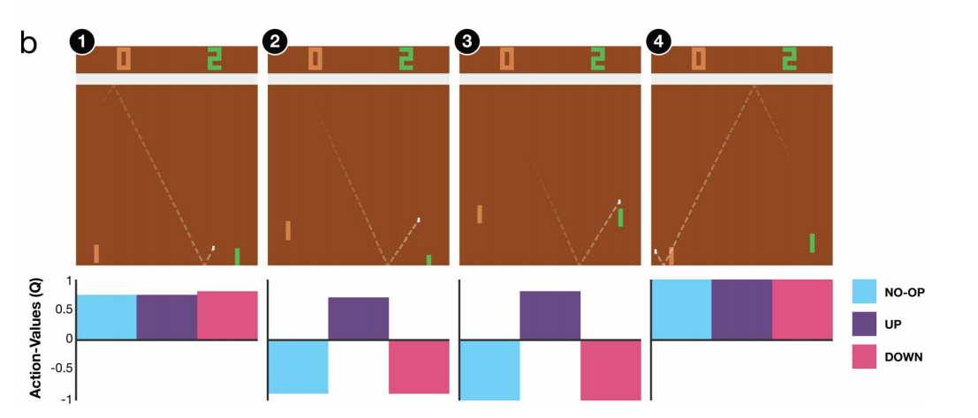
Show it working

Slide 7
Reinforcement Learning Quick Recap
Actor chooses an action
Action is performed and influences the environment
Based on the new state, the system receives a reward r_{t}
System should learn to choose the action that maximizes the expected discounted reward
Challenge is to learn in spite of sparse, noisy, or temporally shifted rewards

Slide 8
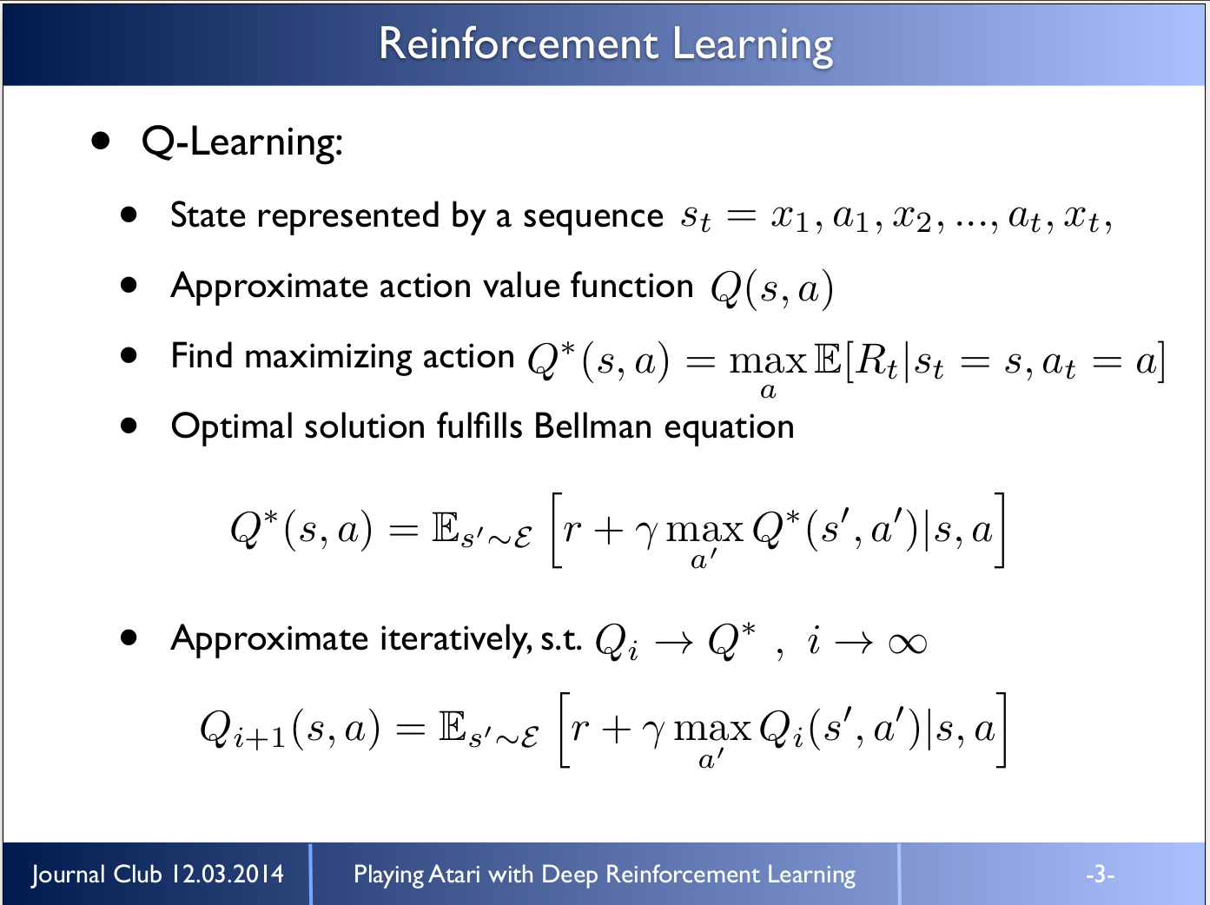

Slide 9
Why function approximation?
Learn a mapping of states to true rewards
Sounds like neural networks (model-free generic function approximators)
Solution: neural networks
Fuzzy mapping from arbitrary features to rewards
Many tools exist to optimize learning

Slide 10
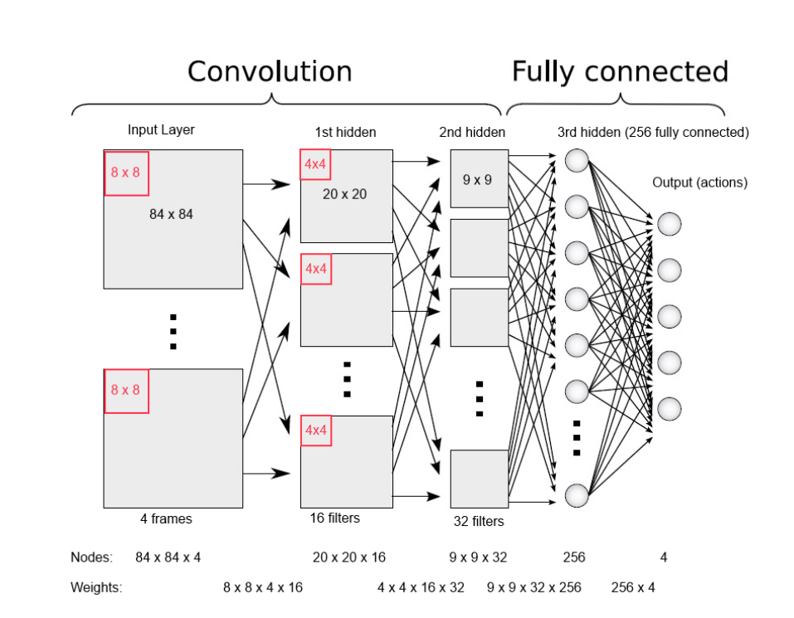
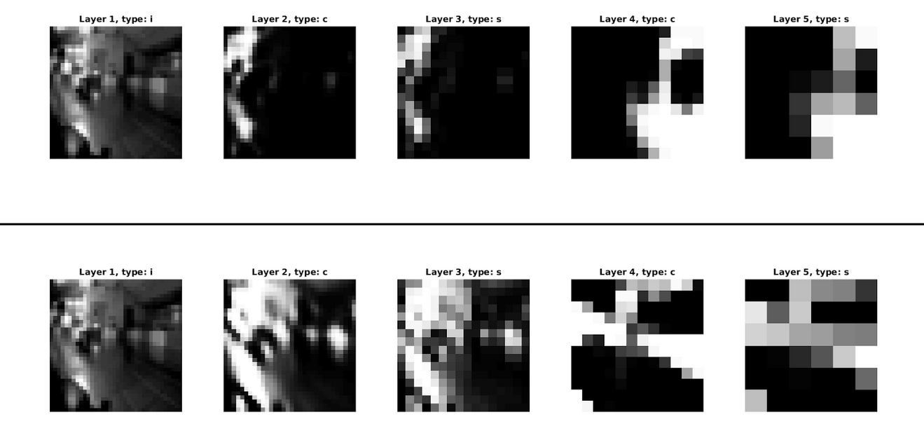
Convolutional Networks

Slide 11
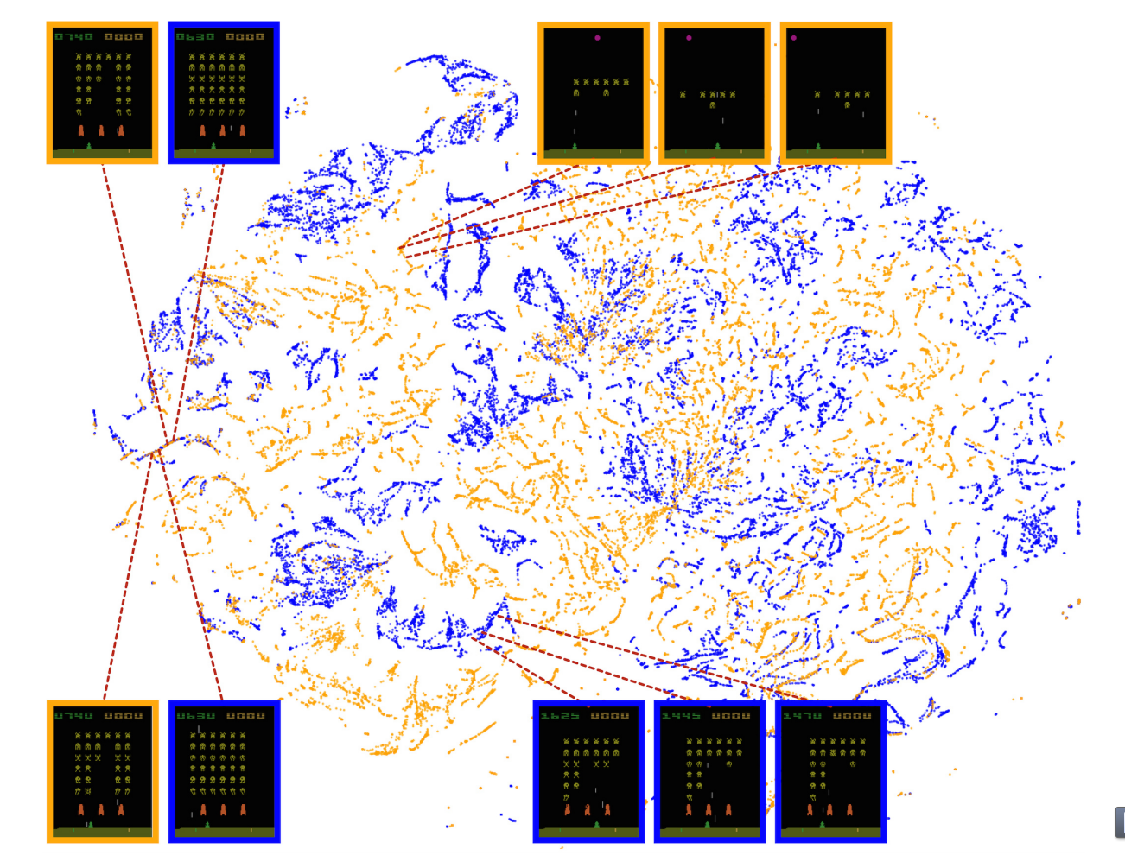
Convolutional Network Embedding

Slide 12
Challenges in NN as Function Approximators
Correlations in successive states
Small changes to Q-estimator may significantly change the policy and the subsequent data distribution
Strong correlations exist between the action-values and the target values
→Leads to feedback loops and instability. How to solve?
One previous approach: lots of randomly initialized networks
Very time costly

Slide 13
Enter DQNs
Two (and a half) key ideas:
Replay memory
Store some memories of the past, and randomly sample from these instead of just the current state
Each memory can influence training more than once (good, efficient)
Random sampling from past breaks consecutive correlations
Behaviour distribution is distributed over history
Target is only updated periodically, allowing the action-value estimator to diverge and reduce correlations
No longer does an increase of Q(s_{t}, a_{t}) increase Q(s_{t+1}, a), avoiding feedback loop
Clip the error rate to (-1, 1)

Slide 14
Code Deep Dive

Slide 15
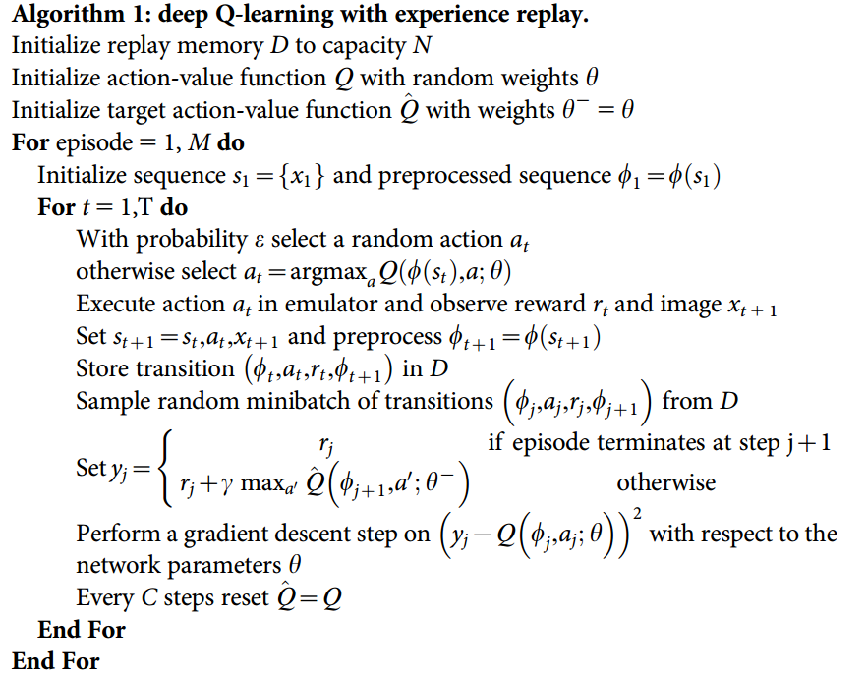
Algorithm Overview

Slide 16
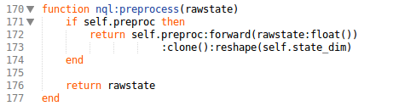
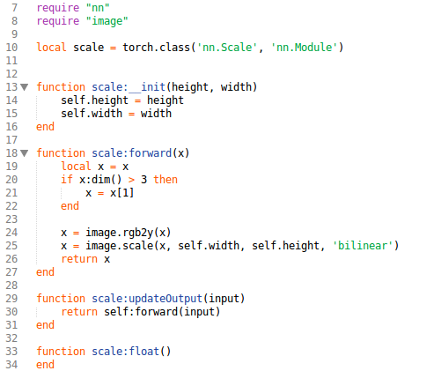
Algorithm Overview - Preprocess

Slide 17
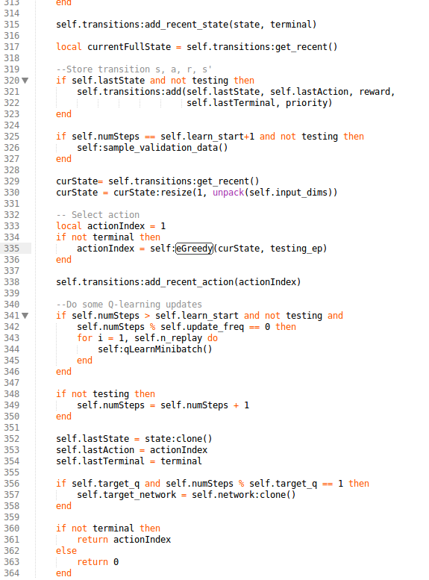
Algorithm Overview

Slide 18
Algorithm Overview

Slide 19
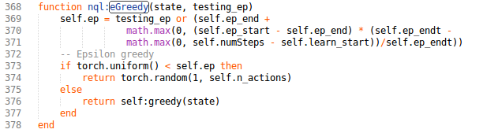
Algorithm Overview – Epsilon Greedy

Slide 20
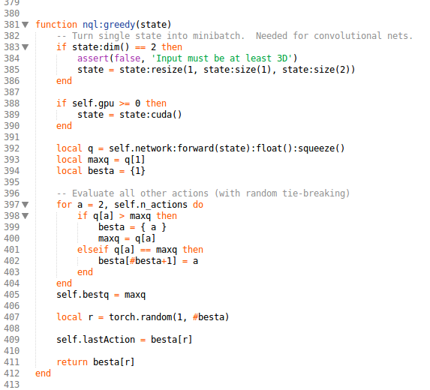
Algorithm Overview – Greedy

Slide 21
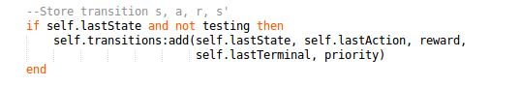
Algorithm Overview – Store in Replay

Slide 22
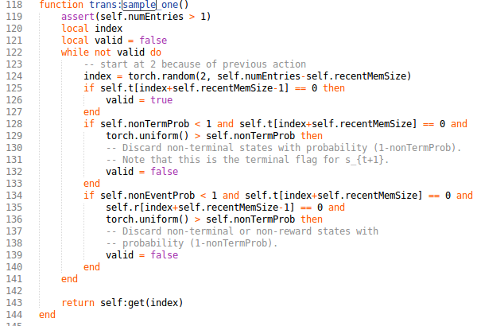
Algorithm Overview – Get Minibatch

Slide 23
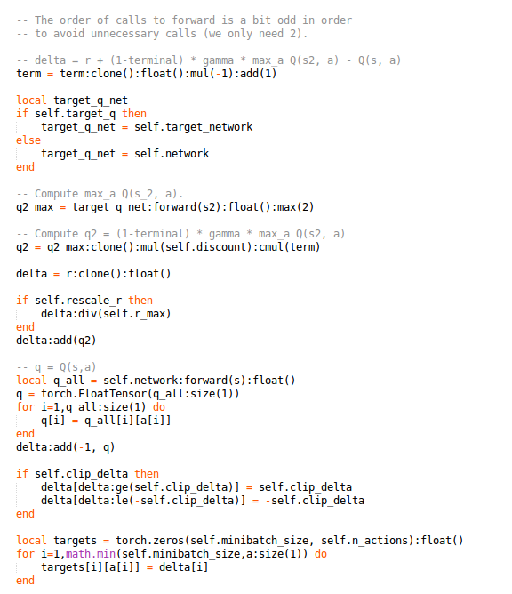
Algorithm Overview – Get Rewards

Slide 24
Algorithm Overview – Update Target Network

Slide 25
What We Can Do

Slide 26
DQNs for Game Playing
For now, train a model using their default architecture
Their parameters are identical across 49 games, indicating some robustness of these parameters
In the future:
Pretrain visual model and reuse between games
Use model selection to pre-initialize game depending on type (puzzle, maze hack-and-slash, Mario-like, racing game, etc.)

Slide 27
Possible Labor Division
Input and Preprocessing
Interface to the game simulator
Represent game state as simplified image
DQN Network without the deep part
Setup epsilon-greedy framework, replay memory, and Q-target copying
Build generalized DQN without the q-estimator part
ConvNet Function Approximation
Set up a simple interface to use the convnet to estimate the rewards

Slide 28
Appendix

Slide 29
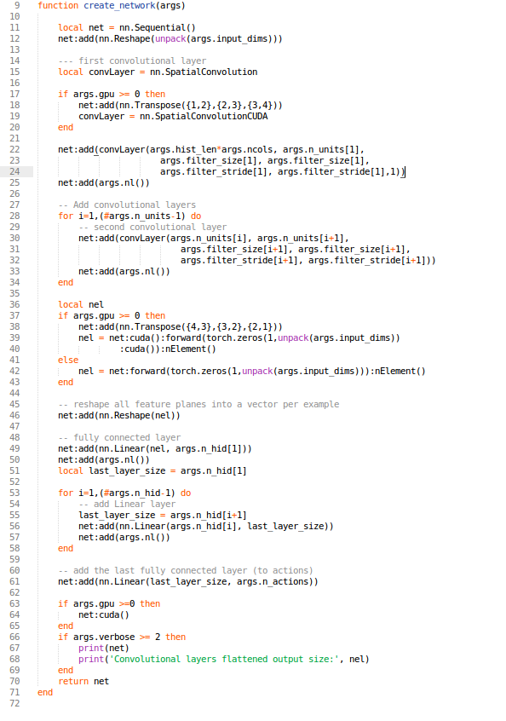
Algorithm Overview ConvNet

